Slide 1
Recipe Search Engine
CS 122 Group Project
Wenxi Xiao
Lerong Wang
Yangyang Dai

Slide 2

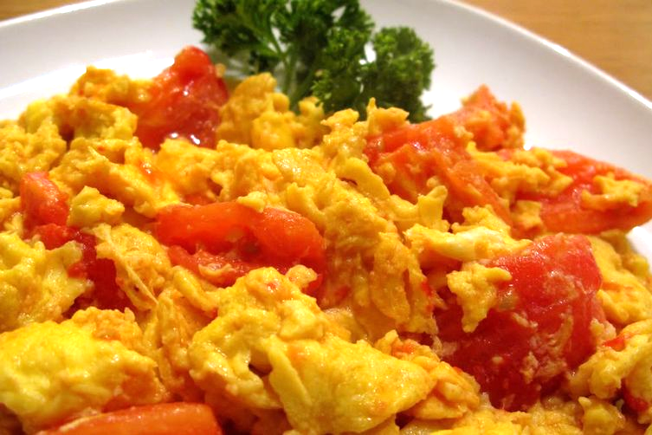

Goal of Our Project

Slide 3
Recipe Search Engine Overview
Search recipe by ingredients
Recipe ranked by the relevancy of ingredients
Specify unwanted ingredients
Develop a user interface using Django

Slide 4
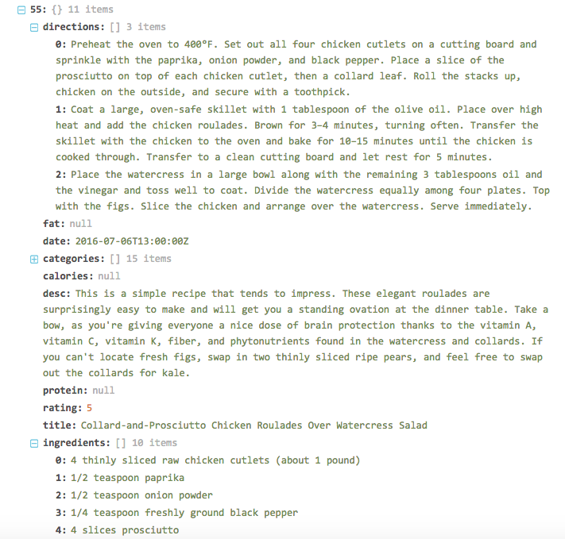
Dataset
Kaggle.com
> 20k JSON
formatted recipes
Preprocessing using nltk package
Each recipe is a document.

Slide 5

Methods
prepossessing
Calculating tf,idf
❖ JSON file Documents Inverted index
❖ Vector Space Model(weight: tf*idf), Cosine Similarity
❖ Probabilistic Model (i.e., Okapi/BM25)

Slide 6
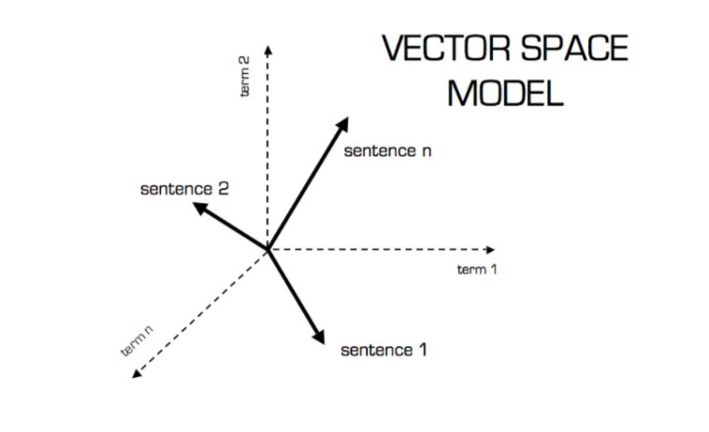
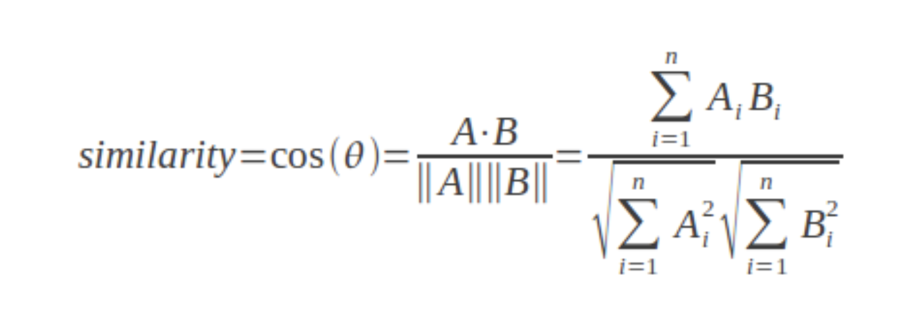
Vector Space Model
(Perone, 2013)
(Nedelcu, 2012)

Slide 7
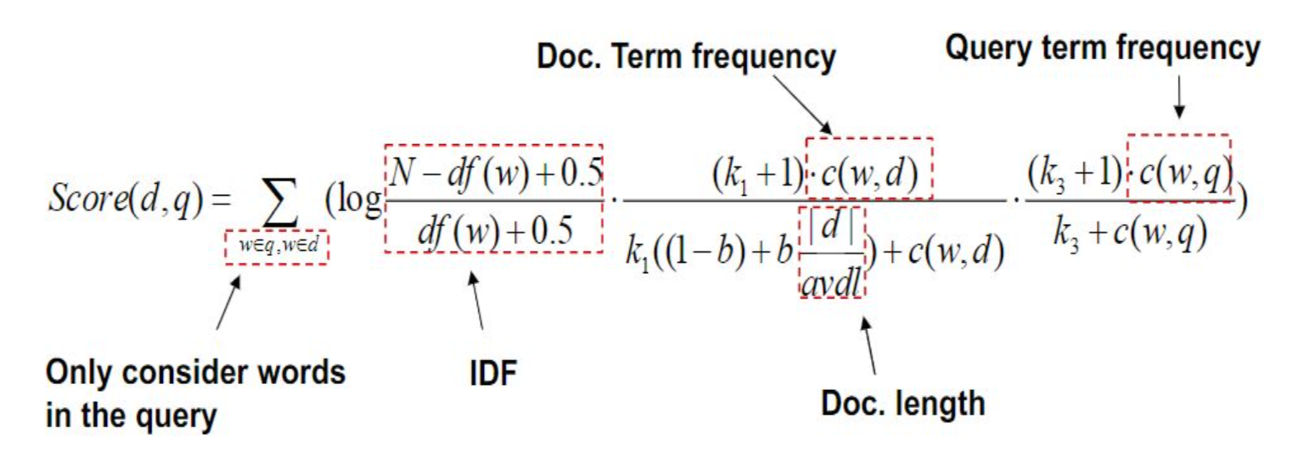
2. Probabilistic Model -- BM25

Slide 8
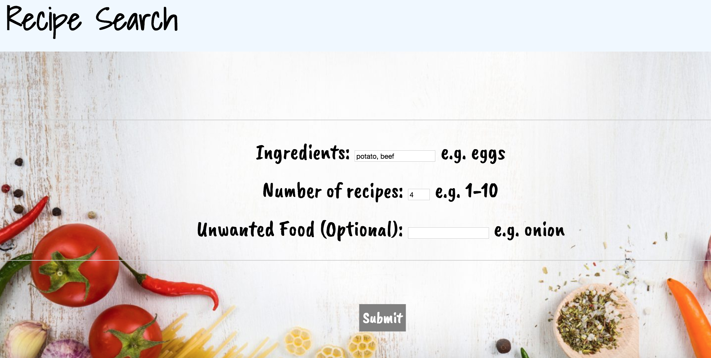
Django

Slide 9
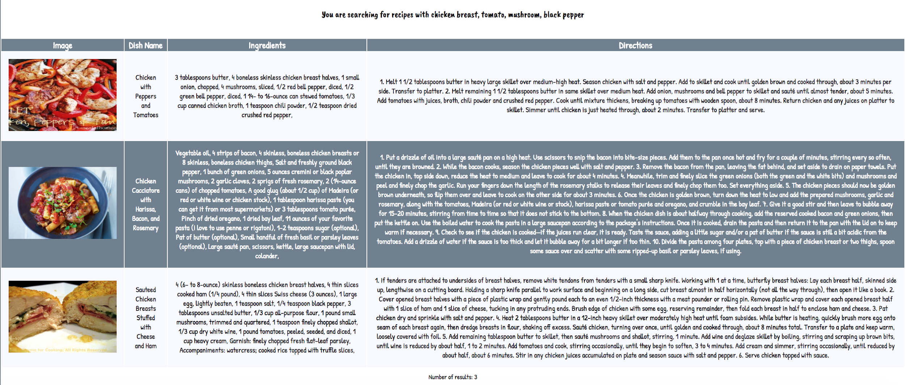
Django
You are searching for recipes with chicken breast, tomato, mushroom, black pepper

Slide 10
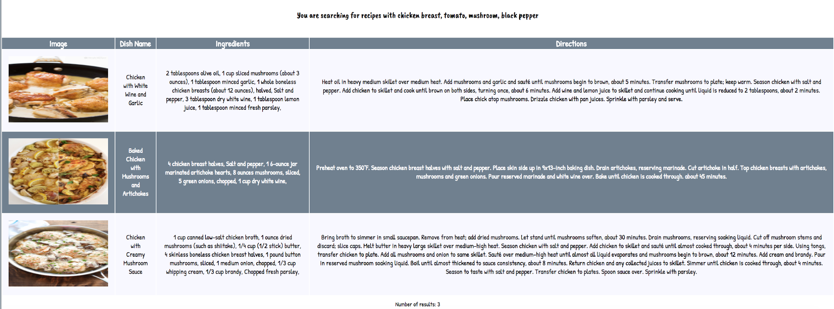
Challenge: Different results when using different models
You are searching for recipes with chicken breast, tomato, mushroom, black pepper

Slide 11
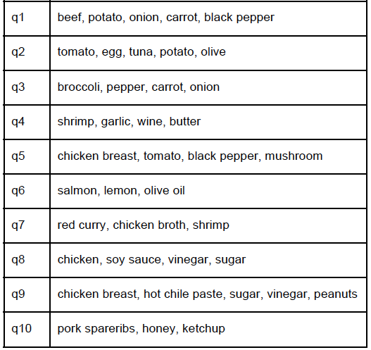


Evaluation
❖ Hard to evaluate
❖ Chose 10 testing queries
❖ Generated ground truth rank for all 10 queries
❖ Calculated Normalized Discounted Cumulative Gain (NDCG) to measure the ranking quality of each model.
(Järvelin & Kekäläinen, 2002)

Slide 12
Comparison between TF-IDF cosine similarity & BM25
Notes:
NDCG score calculated for each model and testing query., (b=0.8, k1=1.2)
We see that BM25 generally has higher NDCG scores than TF-IDF cosine similarity model, meaning that the ranking results obtained from BM25 are closer to the ground truth rank we generated.

Slide 13
Future Work
❖ Make the result display more organized
❖ Improve search speed by building an image database
❖ Develop a classifier using machine learning algorithm to classify the nationality of each recipe, and incorporate this into our user interface

Slide 14
References
Kaggle.com Epicurious-Recipes with Rating and Nutrition, https://www.kaggle.com/hugodarwood/epirecipes/data
Christian, S. Perone. (2013). Machine Learning: Cosine Similarity for Vector Space Models. URL: http://blog.christianperone.com/2013/09/machine-learn ing-cosine-similarity-for-vector-space-models-part-iii/
Alex, Nedelcu. (2012). Data Mining: Finding Similar Items and Users. URL: http://alexn.org/blog/2012/01/16/cosine-similarity-eucl idean-distance.html
Järvelin, K., & Kekäläinen, J. (2002). Cumulated gain-based evaluation of IR techniques. ACM Transactions on Information Systems, 20(4), 422-446.

